Slide 1
GENERAL DESCRIPTION
Throughout the day we are going to use data from one patient to illustrate how to do a CDM. We think only having one data point makes the process more tangible.
We will reuse Lauren:
https://www.endometriosis-uk.org/laurens-story

Slide 2
THINGS TO DO
1/25 - Generate all data assets (Lauren raw, Synthia, Achilles)
2/1 - Initial Deck Draft Completed
3/1 - Amazon WS Built
3/15 - Practice Presentation

Slide 3
HOMEWORK
Read Lauren
Review the Synthea structure (data description)
If you have specific questions please submit them.

Slide 4
OMOP Common Data Model Extract, Transform & Load Tutorial
Clair Blacketer
Mui van Zandt
Erica A. Voss

Slide 5
What this tutorial will provide . . .
Suggested process for developing a CDM ETL
OHDSI ETL tools: White Rabbit, Rabbit-In-A-Hat, and Usagi
Resources like the CDM Wiki and THEMIS
Generation of a simple ETL

Slide 6
Agenda

Slide 7


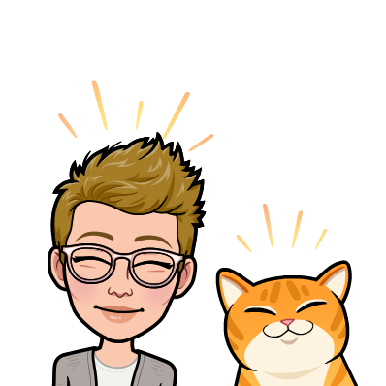
Instructors
Clair Blacketer | Mui van Zandt
Erica Voss

Slide 8

Ground Rules
We are recording
We may take some questions off-line

Slide 9






OHDSI in a Box
Needs updating once we secure the box
Microsoft SQL Server
synpuf_100k
cdm
webapi
Atlas
synpuf_2.3m
WebTools
WebAPI
WhiteRabbit
Microsoft SQL Server Management Studio
Tomcat
RabbitInAHat
Methods Library
Usagi
OHDSI R packages
Studio

Slide 10
OHDSI

Slide 11
Why CDM?
http://forums.ohdsi.org/t/reasons-to-ohdsis-omop-cdm/5273
Maybe find a diverse stakeholders for ideas
Talk to Peter to help us flesh out this slide a bit
Why for a regulatory
For a pharma company
Why for a researcher
Why for data sources
Why for enterprisess

Slide 12
QUICK RECAP OF CDM AND VOCAV

Slide 13



ETLing Best Practices
Data experts and CDM experts together design the ETL
People with medical knowledge create the code mappings
A technical person implements the ETL
All are involved in quality control

Slide 14







ETL Process
ETL
Data experts and CDM experts together design the ETL
People with medical knowledge create the code mappings
All are involved in quality control
A technical person implements the ETL
OHDSI Tools
White
Rabbit
Rabbit In a Hat
Usagi
White
Rabbit
ACHILLES
Rabbit In a Hat

Slide 15
ETL Process
ETL
Data experts and CDM experts together design the ETL
People with medical knowledge create the code mappings
All are involved in quality control
A technical person implements the ETL
OHDSI Tools
White
Rabbit
Rabbit In a Hat
Usagi
White
Rabbit
ACHILLES
Rabbit In a Hat

Slide 16
DRAW AN ETL IMAGE
This can recurre throughout so people know where they are
Add images of the tools in the process map
Later in the deck, we can augment the ETL build to include ETL maintence
Like include data is updated, CDM changes, you are adopting a Vocabulary, bugs
Maybe pull in the CPRD paper comparing Raw vs CDM

Slide 17
Make sure to drive home that we need to use standard codes
And SOURCE vs STANDARD

Slide 18


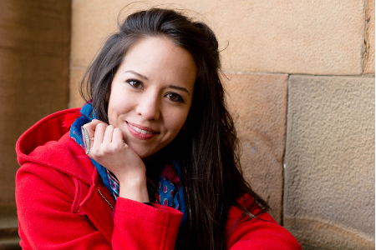
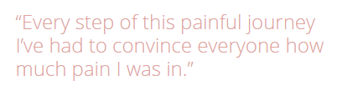
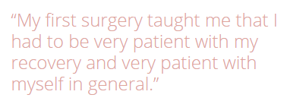
A Patient’s Story: Lauren
https://www.endometriosis-uk.org/laurens-story

Slide 19
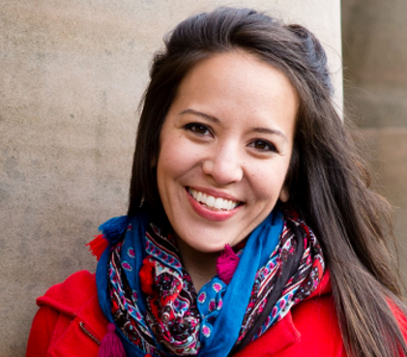
What data do we have?
dysmenorrhea
abdominal pain
missed work
missed work
acetaminophen
acetaminophen
acetaminophen
GP visit
ultrasound
pelvic exam
cyst of ovary
Hospital Visit
severe pain
temp 103°F
CT Scan
ambulance
Bloated abdomen
ascites
surgery
endometrioma
Lauren’s Timeline
Endometriosis
/ /
/ /
-3 Years
-2 Years
-1 Years
-2 Weeks
-3 Days
Day 0

Slide 20
Data experts and CDM experts together design the ETL

Slide 21
Give data layout of Synthea
Data dictionary could be translated into English or a language of your choice will help

Slide 22
White Rabbit
Run on just Lauren’s data (will be fast)
talk through the results
Find a funny thing to show up on scan to review
Many people in the room are data custodians, and how those people are important to the ETL process

Slide 23
Rabbit-in-a-Hat
Walk through tables of interest
Person table
Observation period table
Condition table
Drug table
Reveal whole document
https://github.com/OHDSI/ETL-Synthea/blob/master/Design/RabbitInAHatDesign.docx

Slide 24
Resources
CDM Wiki
THEMIS

Slide 25
People with medical knowledge create the code mappings

Slide 26
USAGI
Do non-English example
5 dutch conditions (IPCI codes)
Show how to create STCM or add to Vocab

Slide 27

WORKING LUNCH?
Please return in 1 hour
We’ll be available to answer questions

Slide 28
A technical person implements the ETL

Slide 29
Basic ETL
Basic SQL ETL
Discussion about investing in having people help you
Testing (show this – not something for people to try in class)

Slide 30
All are involved in quality control

Slide 31
Quality
What is synthea
Review of Synthea+Lauren HEEL
Lauren is a zombie

Slide 32

ETL Pain Points

Slide 33
80/20 rules
TA office hours: 1:1 advice
Losing data and gaining data
How do you make sure you have quality of data
Examples of bad structures (example of DX1,2,3,4) - Give example of the complexity
ETL real world scenario
Sign off on an ETL complete, or handling Vocab updates
How do you update it?

Slide 34
Show some examples of Metadata from CCAE drop off – losing data
Things you should be thinking about to do with a data custodian

Slide 35
Advanced questions time?

